Slide 1
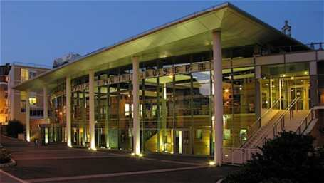

MR of Pancreas and biliary Imaging : How I do it? :
Dr Isabelle Boulay-Coletta
Dr Marc Zins
Saint Joseph Hospital, Paris
Notes:
Answer : D

Slide 2
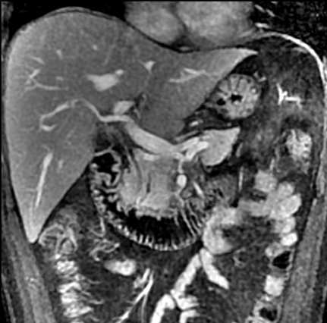
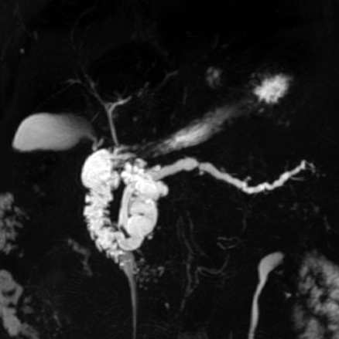
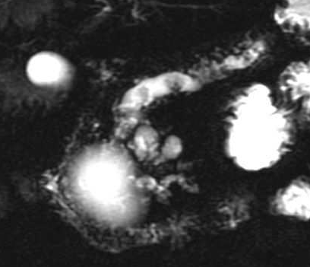
Why ?
How ?
Clinical Cases
Conclusion
Performing Pancreatic MRI
Admited Indication
  Cystic lésions IPMN ++
  Chronic pancreatitis
  Borderline Indication
  Adenocarcinoma
  Neuroendocrine tumor
  Acute pancreatitis
Notes:
IPMN ++ = TIPMP

Slide 3
Why ?
How ?
Clinical Cases
Conclusion
Advantages
One complete exam « all in one »
- Parenchyma study
- Vascular study: Angio MRI
- Duct study: wirsungo MRI
Trede M et al : Ann Surg, 1997

Slide 4
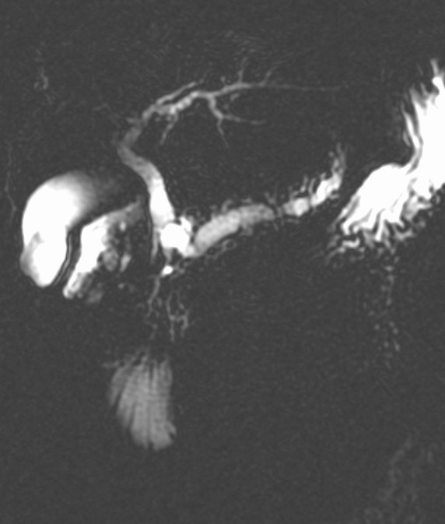
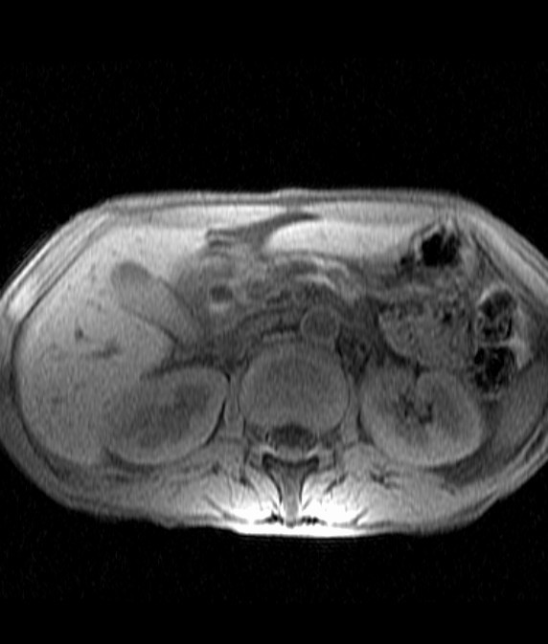
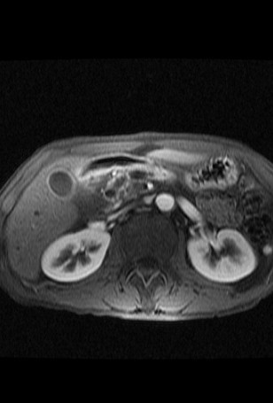
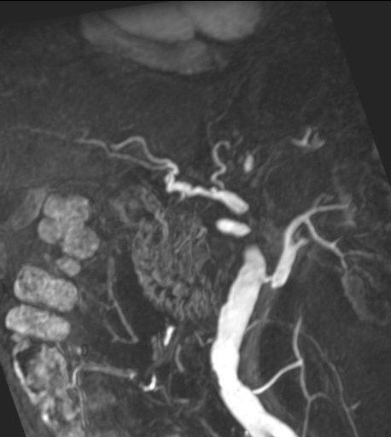
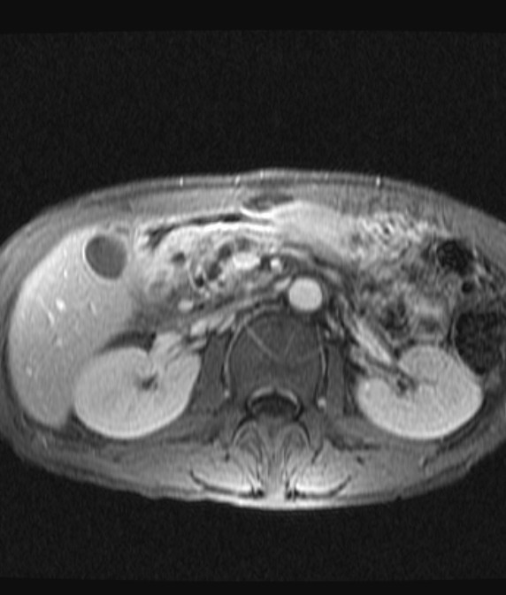
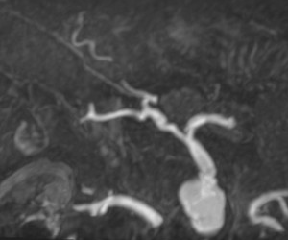
MRI 1999
Basics Of MRI:How I Do It AFIIM -ISRA 2016

Slide 5
Why ?
How ?
Clinical Cases
Conclusion
Pancreas MRI: Technic
Standard Protocol:
  FRFSE T2 Fat Sat (Liver + / Pancreas)
  EG -3D T1 +++Dixon (lava flex)
  MRCP-MRI 2D SSFSE (ax and coro) and /or 3D FRFSE
  Diffusion ++ (liver)
    Focus Diffusion (pancreas)
  EG T1 Fat Sat 3D + Gadolinium
  - arterial phase, portal et delay phase (coronal 3’ and axial 5’)
Scanning time 30-40 mm
Basics Of MRI:How I Do It AFIIM -ISRA 2016

Slide 6
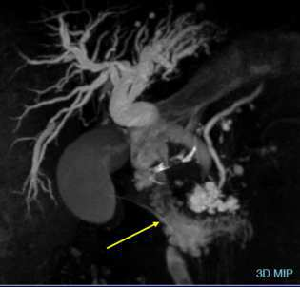
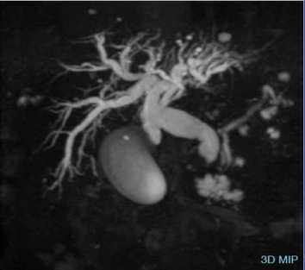
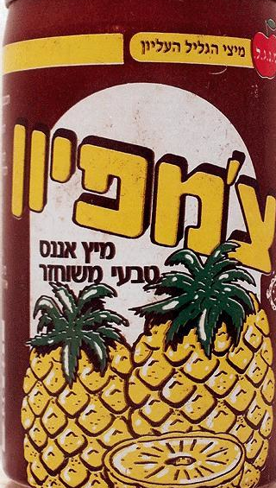
Why ?
How ?
Clinical Cases
Conclusion
Pancreas MRI: Preparation
Fasting during 3-6h
Negative oral contrast (pineapple juice)
Antiperistatic agent (glucagen)
￼
Notes:
Fasting during 3-6h prior the exam to reduce seceetion fluid in the stomach and duodenum and boweli ncrease gallblader distension and reduce duoenal motion

Slide 7
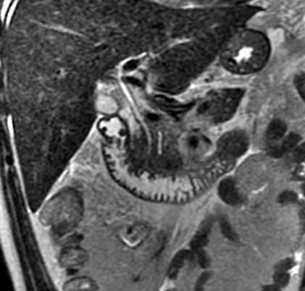
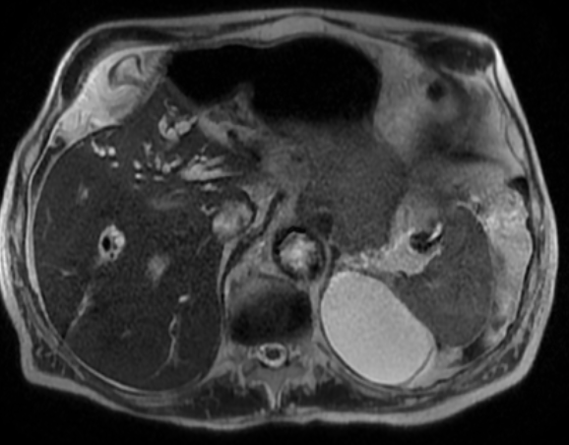
Why ?
How ?
Clinical Cases
Conclusion
  MR Cholangiopancreatography:
  Half Fourier acquisition Single Shot: Short TE
SS FSE (GE)
  HASTE (Siemens)
  SS TSE (Philips)
+
CORONAL
AXIAL
Notes:
Fasting during 3-6h prior the exam to reduce fluid in the stomach and bowelincrease gallbladre distension and reduce duoenal motion
No phase wrap: une option pour supprimer le repliement on diminue le sigan sur bruit. Autre methode augmenter le champs.

Slide 8
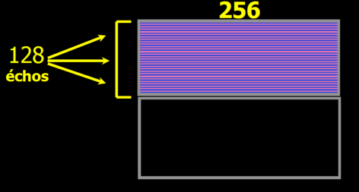
Why ?
How ?
Clinical Cases
Conclusion
  2D MR Cholangiopancreatography:
  Half Fourier acquisition single shot
SHORT TE
Turbo spin T2 acquisition with
A high echo train + Half Fourier acquisition
TR= 720 ms TE eff 99 ms
Turbo factor = 144 echos
Large field of view to reduce Wrap artefact
      Breath hold (20-30s) in one or two (breath hold)
      - Thickness 4 mm/ 0.4 mm
Calculated
Notes:
Fasting during 3-6h prior the exam to reduce fluid in the stomach and bowelincrease gallbladre distension and reduce duoenal motion
No phase wrap: une option pour supprimer le repliement on diminue le sigan sur bruit. Autre methode augmenter le champs.

Slide 9
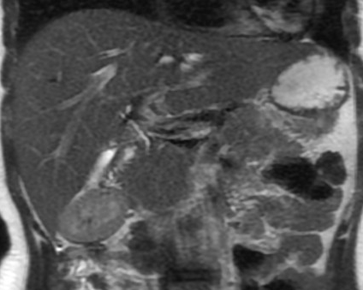
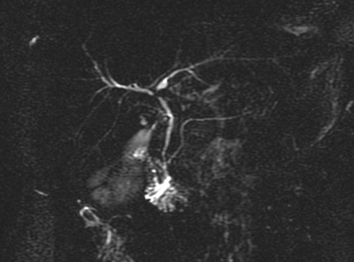
Why ?
How ?
Clinical Cases
Conclusion
  2D MR Cholangiopancreatography:
  Half Fourier acquisition single shot Short TE:
  Avantage /limitation
High Contrast for liquid >> Biliary and pancreatic duct
+
Moderate spatial resolution >> Surrounding anatomy
Basics Of MRI:How I Do It AFIIM -ISRA 2016
Notes:
Fasting during 3-6h prior the exam to reduce fluid in the stomach and bowelincrease gallbladre distension and reduce duoenal motion

Slide 10
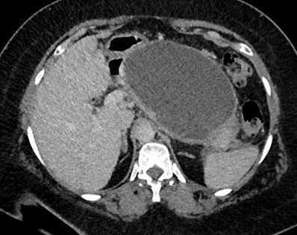
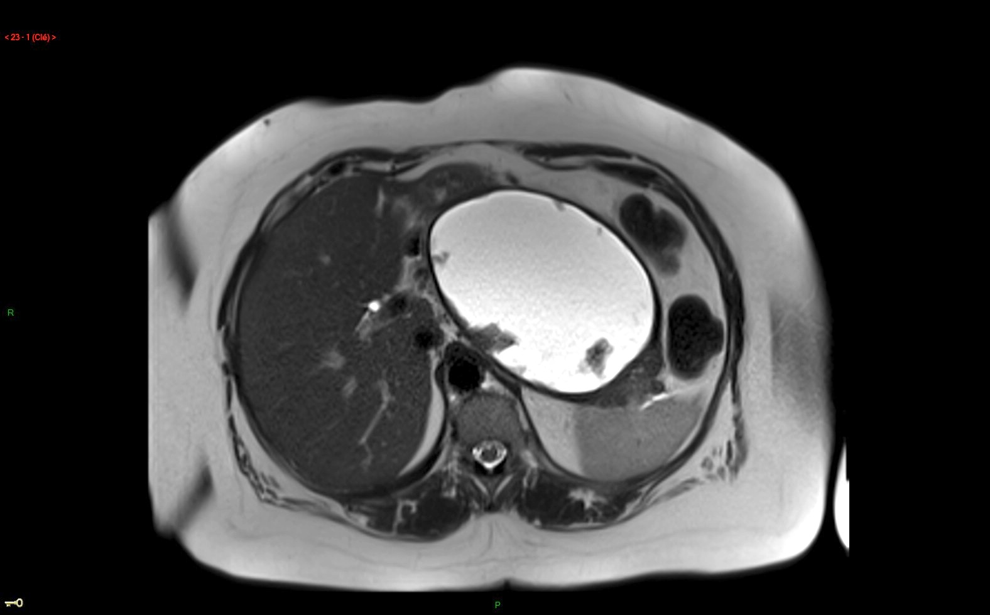
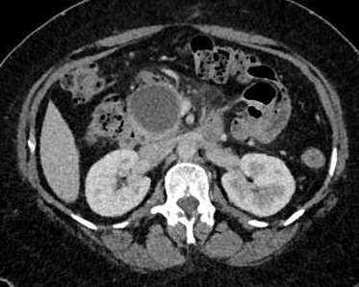
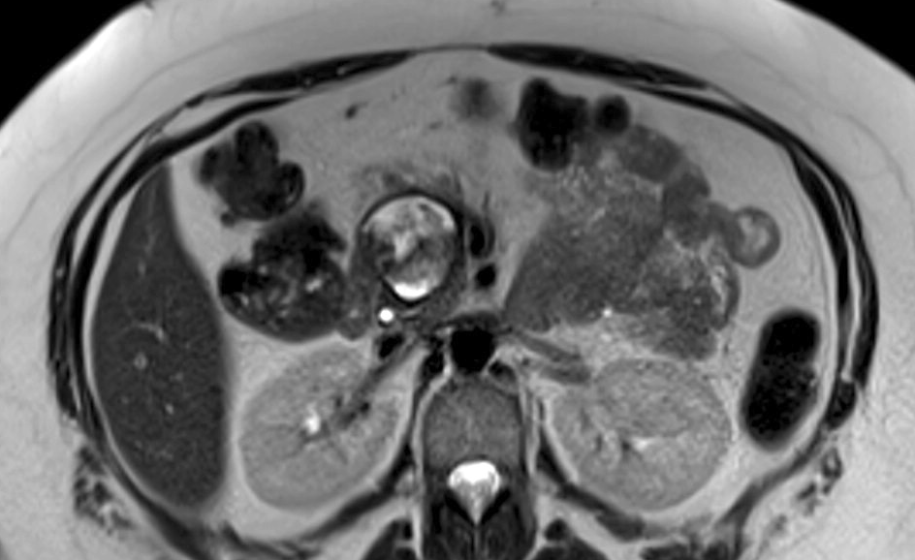
Why ?
How ?
Clinical Cases
Conclusion
  2D MR Cholangiopancreatography:
  Half Fourier acquisition single shot Short TE:
  Useful for
Acute pancreatitis
  ANC
  (acute necrosing collection)
  WON (wall off necrois)
≠pseudo cyst
< 4 weeks
Courtesy AM Chuong
45 yrs old male, acute pancreatitis; Day 32
Basics Of MRI:How I Do It AFIIM -ISRA 2016

Slide 11
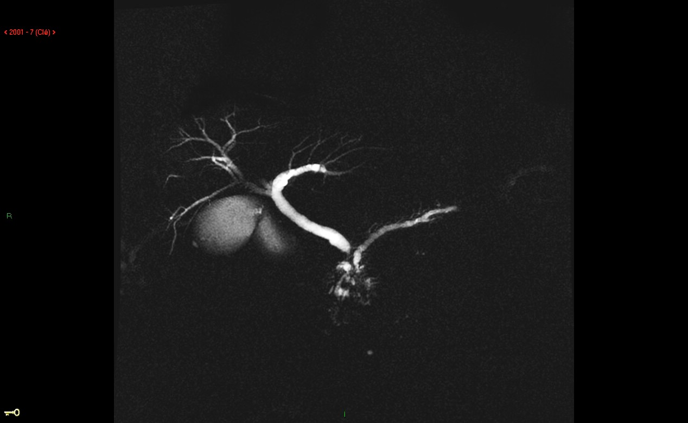
Why ?
How ?
Clinical Cases
Conclusion
  MR Cholangiopancreatography:
  Half Fourier acquisition single shot: long TE
  SS FSE long TE, RARE, SS TSE long TE
2D Coronal
  2D Coronal view +++
  T2 Turbo spin echo
    TR 6000 ms, Long TE 1183 ms >> high T2 weighted
  > only liquid images
  Breath hold (2s) duration time 1.33 min (16 slices)
  Thickness 20 mm intersapce 10 mm
Basics Of MRI:How I Do It AFIIM -ISRA 2016
Notes:
Technique acquisition de la moitié du plan de fournier avec un facteur turbo plus important (le double que à te court), que le signal des liquid qui stagnent car seul les derniers protons à se dephaser donneront du signal.
A chaque apnee une impulsion de radiofrequence est envoyé 2s on attend 4 s le rephasage puis nouvelle impulsion de radiofrequence.
Dilatation bicanalaire avec pancréatopathie obstructive en amont (dilatation en flammèches de canaux secondaires)
Interet d’avoir des coupes epaisses car le signal diminue avec le TE.
-> Adénocarcinome du crochet du pancréas

Slide 12
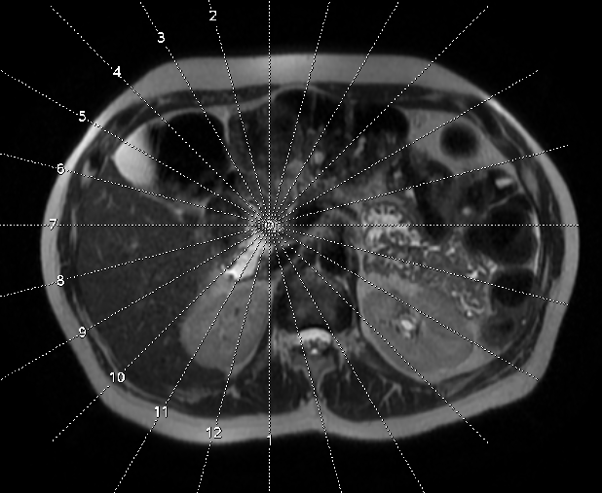
Why ?
How ?
Clinical Cases
Conclusion
  Optional MRCP: 2D Radial MR Cholangiopancreatography
    Radial 15 thick slab of 20 mm centered on the choledocal duct
    Breath hold: 2s Total acquisition time 1.30 min
Notes:
Fasting during 3-6h prior the exam to reduce fluid in the stomach and bowelincrease gallbladre distension and reduce duoenal motion

Slide 13
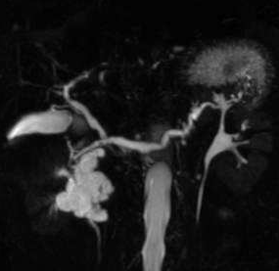
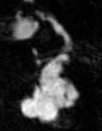

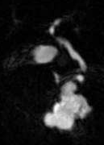
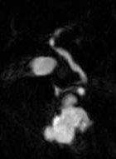

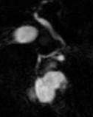

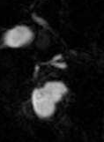
Pancreas MRI: radial MRCP
IPMN: Demonstrating communication with the MPD
1
2
3
4
5
6
7
8

Slide 14
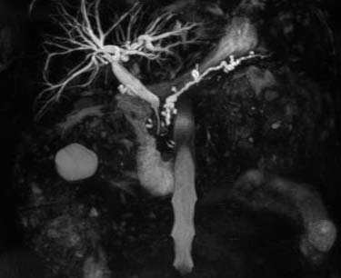
Why ?
How ?
Clinical Cases
Conclusion
  3D MR Cholangiopancreatography
    3D FR FSE (fast recovery fast spin echo), 3Dfast recovery RARE,
    Turbo fast spin echo
    TR 2857- TE 914
    3D heavily T2 weighted images
    Free breathing (1.2mm/0.6),
      Slow breathing >> long acquisition time
      Fast breathing >> no time for rephasing RF pulse > increase acquisition time
    173 slices, (2.30-5 min), 3D MIP reformat
FRFSE 3D
Basics Of MRI:How I Do It AFIIM -ISRA 2016
Notes:
Fast recovery is an extra pulse to accelarate of the longitudinal magnetisation back to the longitudinal axis instead of relying solely on T1 relaxation for this recovery. Fluid is highlighted. Other key feature is parallele imaging

Slide 15
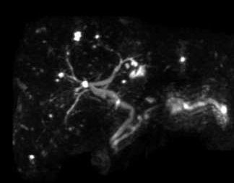
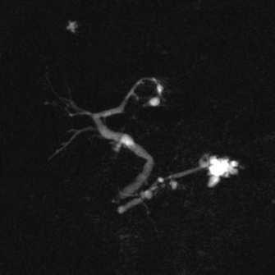
Why ?
How ?
Clinical Cases
Conclusion
  3D MR Cholangiopancreatography
    3D FR FSE , 3D RARE,
Avantage:
Good spatial resolution
>> to detect communication between cyst and pancreatic duct
Limitation +++
- Sensitive to artefact (gosting, blurring) >> 3T
>> Moderate reproductivity
- Long acquisition time
Follow up of a IPMN
3D FRFSE
2D SSFSE
Motion artefarct

Slide 16
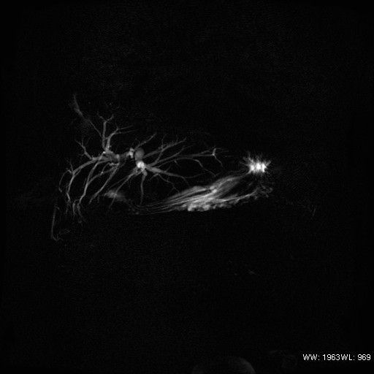
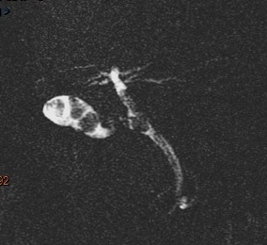
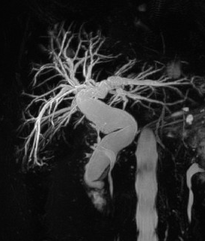
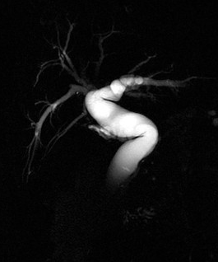
Why ?
How ?
Clinical Cases
Conclusion
  MR Cholangiopancreatography need for
Biliary duct:
  Stone, cholangitis, tumor , cystic variant, choledochal cyst,
3T coro 2D
3T coro 2D
MIP coro 3D
coro 2D
Gallblader and common
bile duct stone
cholangitis in a 34 yrs old
patirent with IBD
Follow up of a choledocal cyst
in a 78 years old female
Notes:
Fasting during 3-6h prior the exam to reduce fluid in the stomach and bowelincrease gallbladre distension and reduce duoenal motion
Follow up of a choledocal cyst in a 78 years old female.

Slide 17
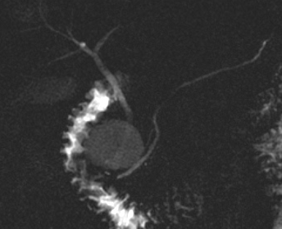
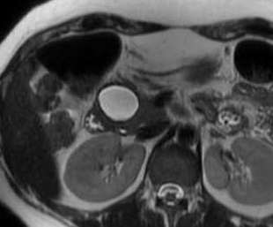
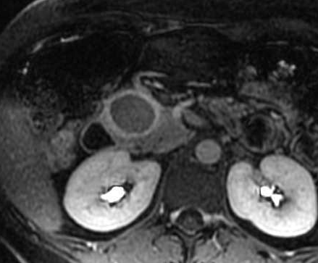
Why ?
How ?
Clinical Cases
Conclusion
  MR Cholangiopancreatography need for
Pancreatic duct study:
-Branching cyst or not on the pancreatic duct :
- Localizing stop on the pancreatic duct >>> Tumor +++
- reduced size of the main pancreatic duct >> Auto Immune P
- Morphological feature of secondary pancratic duct: chr pancreatitis
32 yrs old female. Typical appearance of Mucinous Cystadenoma
Notes:
Fasting during 3-6h prior the exam to reduce fluid in the stomach and bowelincrease gallbladre distension and reduce duoenal motion

Slide 18
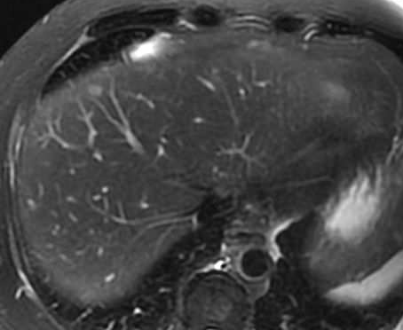
Why ?
How ?
Clinical Cases
Conclusion
FR FSE T2 Fat Sat
  Liver + Pancreas
    respiratory triggered
    TE : 90 ms / TR 12857/ 3Nex
    Thickness : 5mm/1.5mm
    Acquisition time 5 min
Notes:
To caracteriez liver nodule, moderate high signal T2 for met

Slide 19
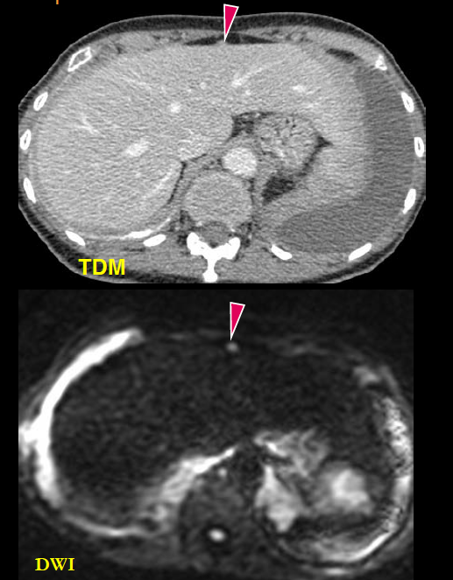
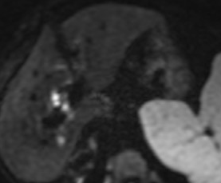
Why ?
How ?
Clinical Cases
Conclusion
    Diffusion Weighted Images: DWI
  Diffusion weighted b0/200/400/800
  Respiratory triggered
  Thickness 5-6/0 mm
  Voxel 32mm³
  180 images, 4Nex, (4 min)
    > liver met
    > peritoneal carcinomatosis
    Diffusion Stand

Slide 20
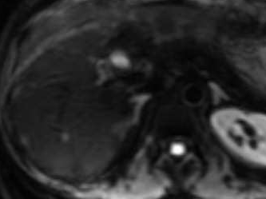
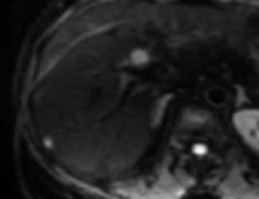
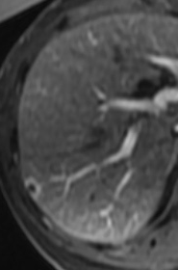
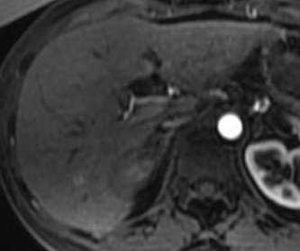
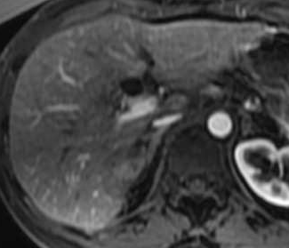
Why ?
How ?
Clinical Cases
Conclusion
A 56 female refered to MRI for a borderline adenocarcinoma with one resectable met on CT

Slide 21
Why ?
How ?
Clinical Cases
Conclusion
    Diffusion Weighted Images: DWI
French Prospective multicenter Trial:
  Added value of MRI with DWI in resectable patients (after Triple Phase MDCT)
  Partial results (125 included patients)
    14% of patients with liver mets only seen at MRI

Slide 22
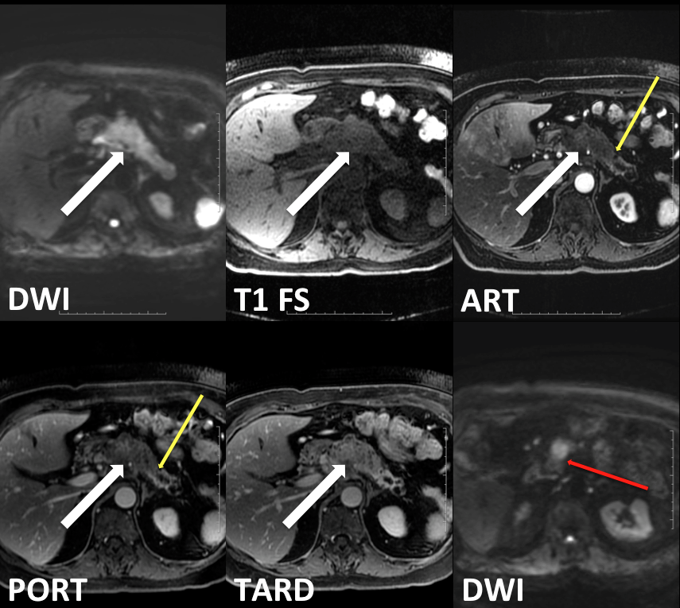
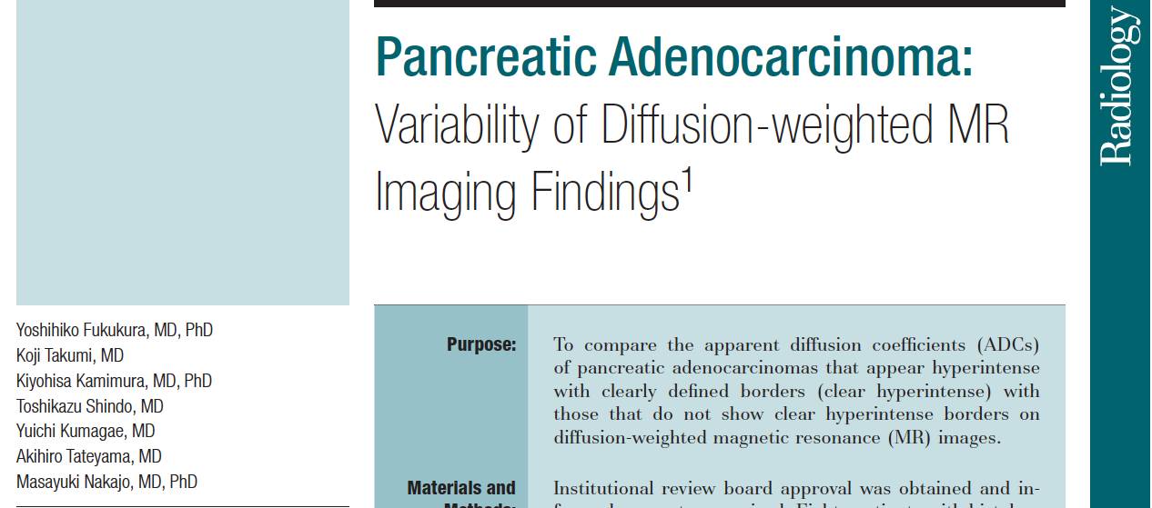
Why ?
How ?
Clinical Cases
Conclusion
    DWI: for pancreas adenocarcinoma ?
2012
80 patients with proved PA, 3T, DWI (b=1000)
Only 47% of hyperintense lesions with clear borders
  Hyperintensity of the distal pancreatic parenchyma
    Obstructive Pancreatitis

Slide 23

Why ?
How ?
Clinical Cases
Conclusion
    Focus Diffusion :
    Fov Optimized and Constrained Undistorted Single-shot
  -TE = 50ms, TR = 5000 – 6000
  b50-500 (EPI), 16 nex
  Thickness 5/0 mm, FOV 160/80/6Nex
  Asymetric FOV (24x12)
  Voxel = 1,5 x 1,5 x 5 (11,25 mm³)
  Phase A/P, 16 coupes
  Respiratory triger
  Acquisition time < 3min
rFOV DWI

Slide 24
Why ?
How ?
Clinical Cases
Conclusion
    Focus Diffusion :
    Fov Optimized and Constrained Undistorted Single-shot
Excitation of the Fov in the frequence direction is reduced by using a selective RF pulse 2D followed by a 180° refocalisation impulsion
Standard Excitation of a slice
Focus

Slide 25


Why ?
How ?
Clinical Cases
Conclusion
    Focus Diffusion :
    Fov Optimized and Constrained Undistorted Single-shot
Endocrine tumor
SSEPI DWI
rFOV DWI
  Advantages:
  Increase spatial resolution by 3 by reducing FOV
  Decrease phase wrap
  Decrease geographic distorsion less air interposition
  No limitation of b value or nb of directions

Slide 26

Why ?
How ?
Clinical Cases
Conclusion
EG T1 Fat Sat 2D or 3D
    Major Sequence in pancreas MRI
    High Negative Prevalence Value +++
    Pathology : hyposignal +++
Pancreatic adenocarcinoma

Slide 27

Why ?
How ?
Clinical Cases
Conclusion
EG T1 Fat Sat multi echo Dixon: 3D (lava flex)
  Major sequence
    High NPV+++
    Abnormality : hyposignal +++
    Breath hold thickness: 2-4mm/1.2
    156 slices (22s)

Slide 28

Why ?
How ?
Clinical Cases
Conclusion
  3D EG T1 Fat Sat + Gadolinium:
  Lava, Vibe, Thrive
  Thickness : 2,5mm, FOV = 40 (80 to 100 slices)
    acquisition plane choice +
    Arterial and portal phase (axial)
    Delayed phase +++ (coronal 3’, axial 5’)
    Angiography sequence

Slide 29


Why ?
How ?
Clinical Cases
Conclusion
3D EG T1 + Gadolinium : arterial phase +++
Best sequence for
Tumor Conspicuity +++
DWI
3D GRE T1 art
22 pts
95% T hypoattenuating in 95%
25% Iso intense in diffusion
Tumor size correlate better with DWI

Slide 30





Why ?
How ?
Clinical Cases
Conclusion
  3D EG T1 + gadolinium: multi arterial phase (axial)
Art 1
Art 2
Art 3
Endocrine pancreas tumor
And metastatsis ++
Portal
T1 Pre contrast

Slide 31




Why ?
How ?
Clinical Cases
Conclusion
    3D EG T1 +Gadolinium +: delayed phase
Portal
Art
Late

Slide 32





Why ?
How ?
Clinical Cases
Conclusion
    3D EG T1 +Gadolinium : Venous phase (axial)
Venous
involvement
portal
MPR
3D T1 T
MPR

Slide 33

Why ?
How ?
Clinical Cases
Conclusion
    Performance of MRI vs CT in pancreas adenocarcinoma
MRI : high accuracy
  High Sens (>90%) for detection
    No significant difference with MDCT
  High accuracy for vascular assessment
    No significant difference with MDCT
  No difference for liver mets detection
    3T, isotropic dynamic 3D T1 (but no diffusion studied)
    Limited sample size+++
2011

Slide 34






Why ?
How ?
Clinical Case
Conclusion
3D T1 art
Art 3D T1
Art 3D T1

Slide 35

Why ?
How ?
Clinical Case
Conclusion
The prevalence of isoattenuating pancreatic cancers was
significantly higher among 20mm or smaller ( P = .033) and well-differentiated ( P =.001) tumors.
130 pts surgically proven PC < 30mm
33 pts with missed PC < 30mm
Isoattenuating PC: 19%
  70 tumours < 20mm
    Prevalence of Isoattenuating PC : 27%
  63 tumours : 21-30mm p = 0.033
    Prevalence of Isoattenuating PC : 13%

Slide 36
Why ?
How ?
Clinical Case
Conclusion
5.4 % (35/644) of isoattenuating cancer at both phases (panc and portal)
  11.4% of resected lesions
Mean Size= 3 cm (1.5-4 cm)
Resectability rate: 86 % +++ vs 36% for hypoattenuating tumours

Slide 37
Why ?
How ?
Clinical Case
Conclusion
Don’t perform a pancreatic MRI without a Pan CT
Perform a pancreatic MRI:
  In an inconclusive CT
  Isodense pancreatic lesion >> High contrast resolution
  In a potential resectable pancreas tumor (adenoK, NET) at CT
    >> High temporal resolution and diffusion
  Cystic lesion and follow up
  Pancreatitis (chr, auto immune P and Acute Pancreatitis ?)

